Slide 1
What is in a plot? A guided tour of a decade of data visualization conferences 2019-09-14

Slide 2
What are we summarizing?
Popular data visualization conferences
IEEE Vis, InfoVis
EuroVis
CHI
Historical trend (2009 – 2019) & best papers (2015 – 2019)
A blatantly biased, opinionated selection of papers (2015 – 2019) to make my point (‘does this finding make me change at least one line of my existing code’)

Slide 3
What are we summarizing?
The why’s
Present results
Making inferences
The how's
How do plot elements and plot types impact information comprehension?
How to cope with the changing data landscape?
How can plots explain complex models?
Low-level choices
High-level choices

Slide 4
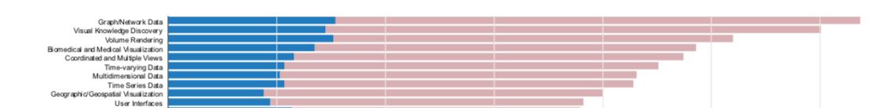
First, I am not the first one to do this…
Isenberg et al (2017)
Absolute number of submitted papers with acceptance percentages (blue–accepted, red–rejected) for the lower-level keywords for all papers submitted to PacificVis, EuroVis, InfoVis, Vis/SciVis, and VAST in 2008–2015

Slide 5
But there is no practice perspective on data visualization research…

Slide 6
Historical trend
Make a word cloud from all the abstracts published in the respective year
https://github.com/pgurazada/Talks/blob/master/abstract-word-clouds.py

Slide 7
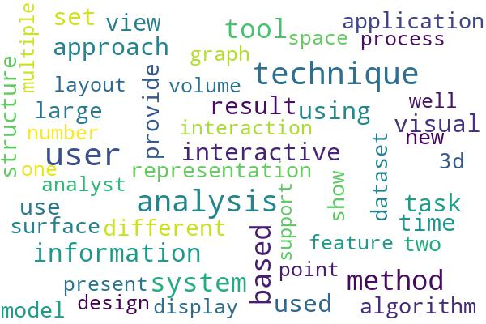
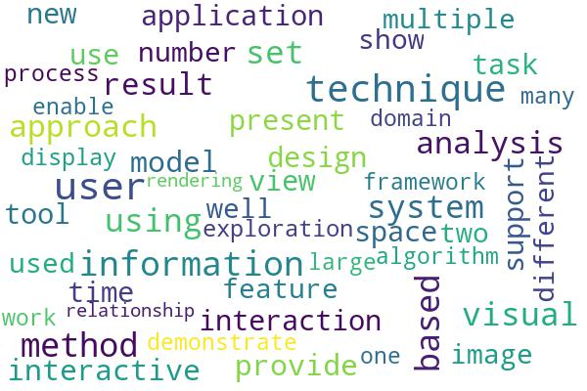
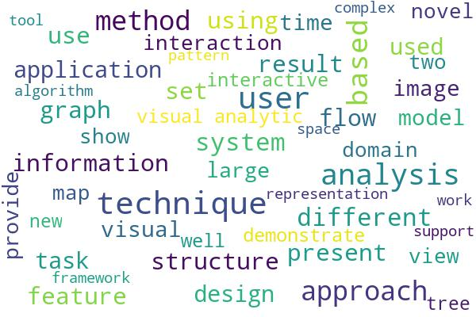
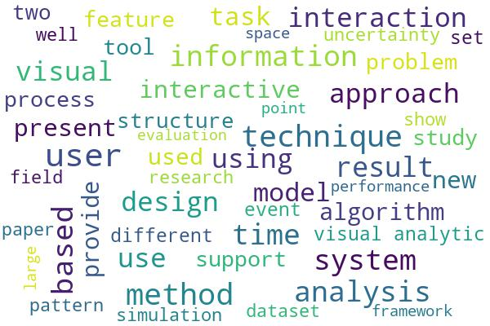
Summarizing the decade (in 50 words)
2009
2010
2011
2012

Slide 8
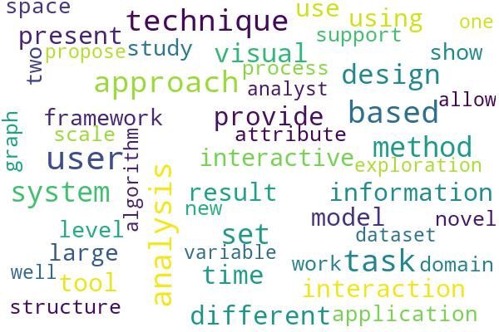
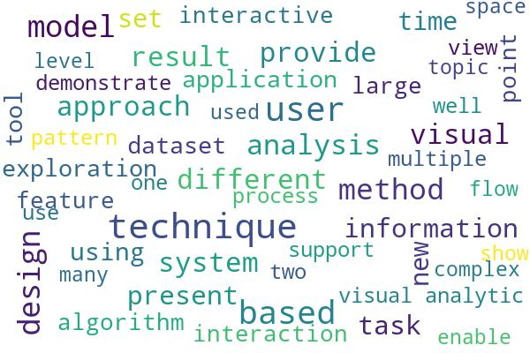
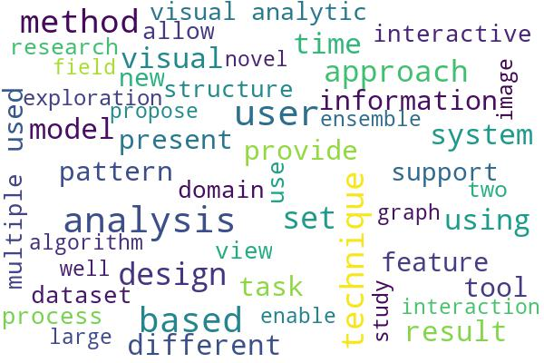
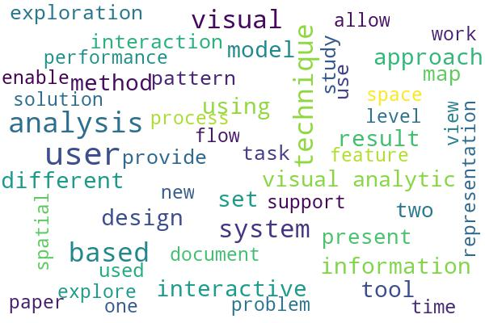
Summarizing the decade (in 50 words)
2013
2014
2015
2016

Slide 9
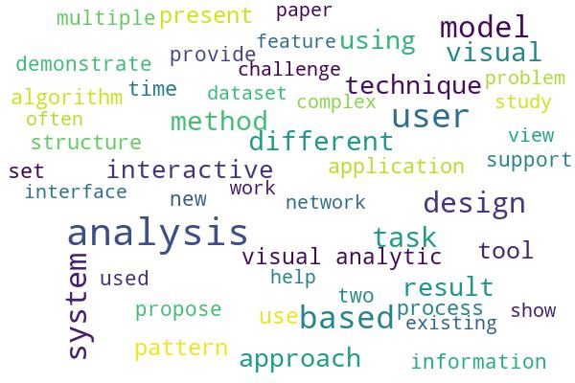
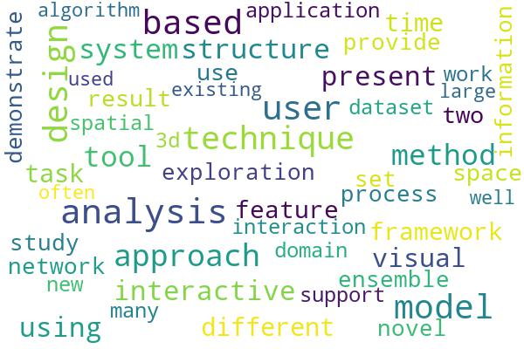
Summarizing the decade (in 50 words)
2017
2018

Slide 10
The why’s

Slide 11
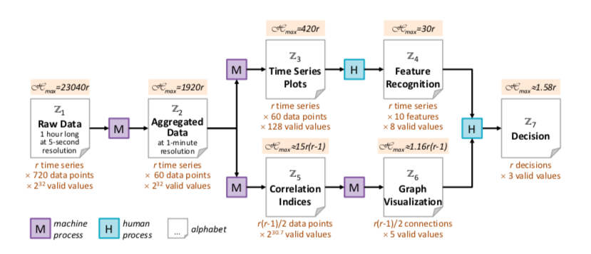
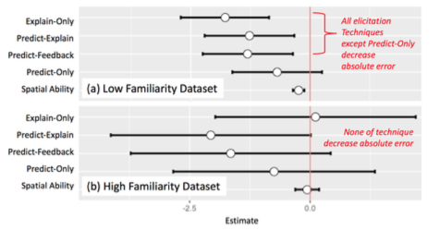
Plots matter to the analyst
A good visualization minimizes time to answer several data questions, spurs insightful questions, conveys an overall sense and generates confidence about the data domain (Wall et al 2018).
Plotting aids decision making by reducing the entropy
(Chen and Golan, 2015)
Plotting and explaining predictions improves data comprehension (Kim et al, 2017)

Slide 12
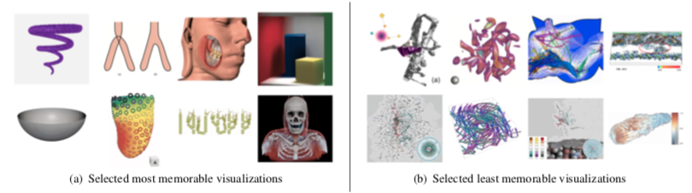
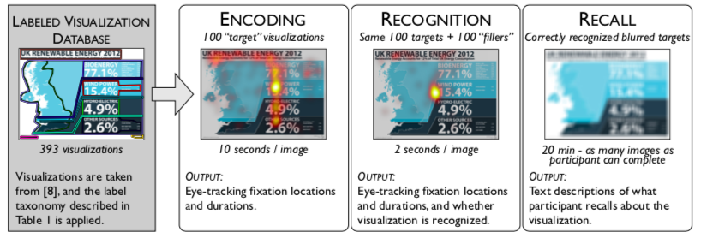
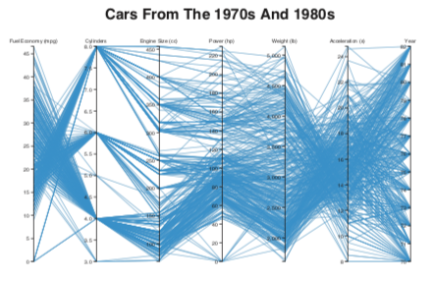
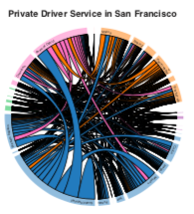
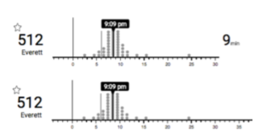
Plots matter to the viewer
Memorable scientific plots have less clutter and less number of
distinct colors (Li and Chen, 2018)
Properly labeled plots increase recognition and recall
(Borkin e al, 2016)
When people encounter unfamiliar visualizations, they undergo a difficult cognitive process (Lee et al, 2016)
Showing uncertainty in predictions aids decision making
(Fernandes et al, 2018)

Slide 13
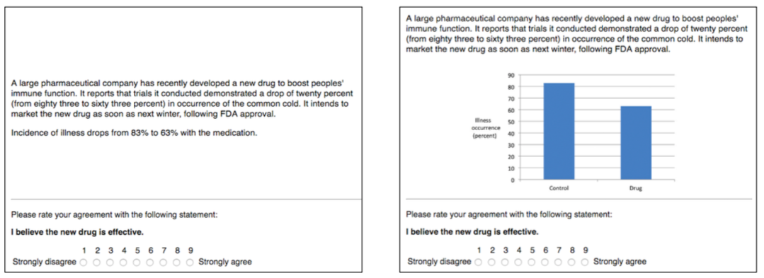
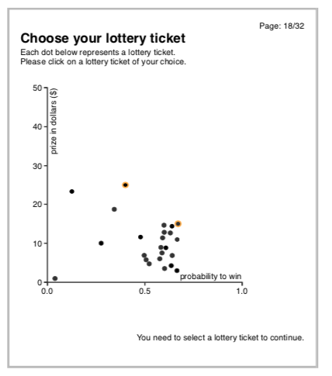
Should I really make a plot?
Addition of trivial charts don’t aid decision making (Dragicevic and Jansen, 2017)
Plots can make some alternatives seem more attractive than they really are (Dimara et al, 2018)

Slide 14
The how’s

Slide 15
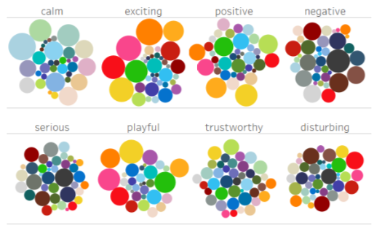
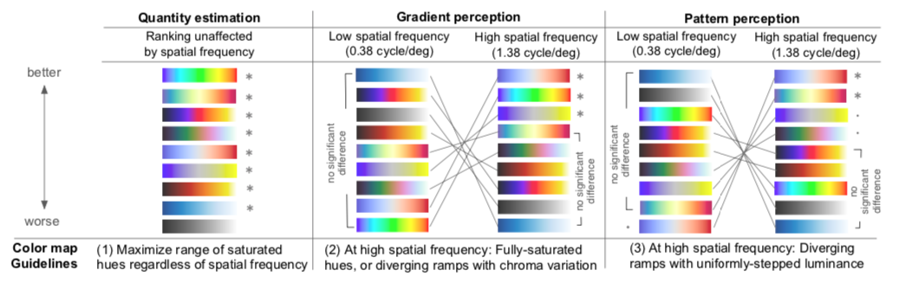
How to choose color?
Appropriate choice of color palette can evoke specific emotion from the visualization (Bartram et al, 2017)
The choice of colormap has an impact on the estimation of metrics from the plot (Reda et al, 2018)

Slide 16
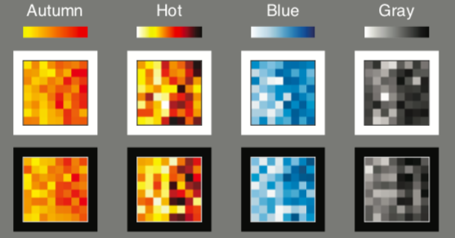
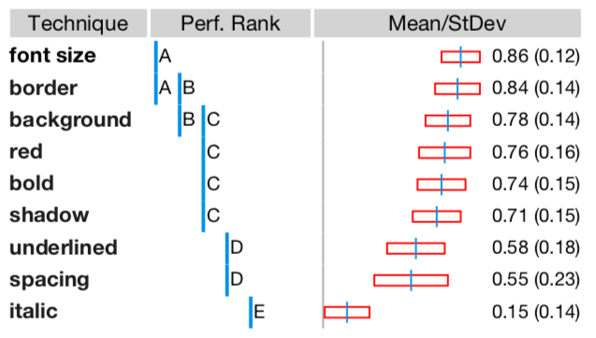
How to choose color?
Use colormaps that will not appear to vary in opacity on any background color; encode larger quantities in darker colors (Schloss et al, 2018)
Specific choices on text highlighting vary on degrees of effectiveness of visual search (Strobelt et al, 2015)

Slide 17
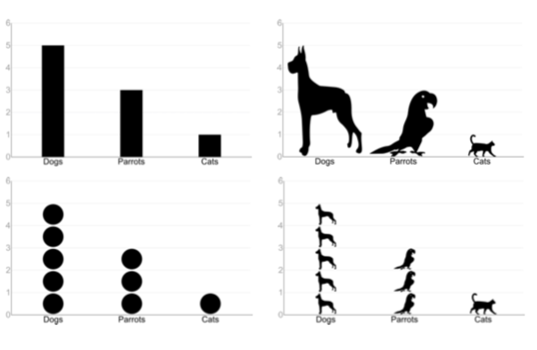
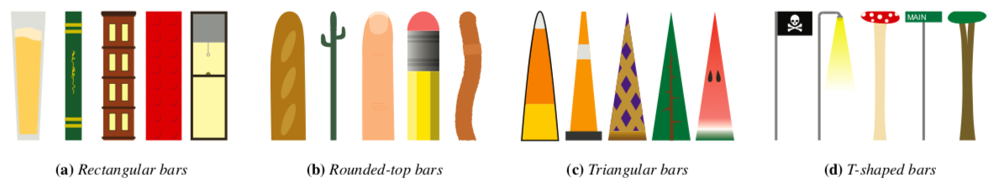
How to choose shape?
Pictographs help in remembering data when the task is demanding, discretization of a bar does not help (Haroz et al, 2015)
Pictorial bar charts reduce accuracy, but not beyond the effect observed for the shapes (Skau and Kosara, 2017)

Slide 18
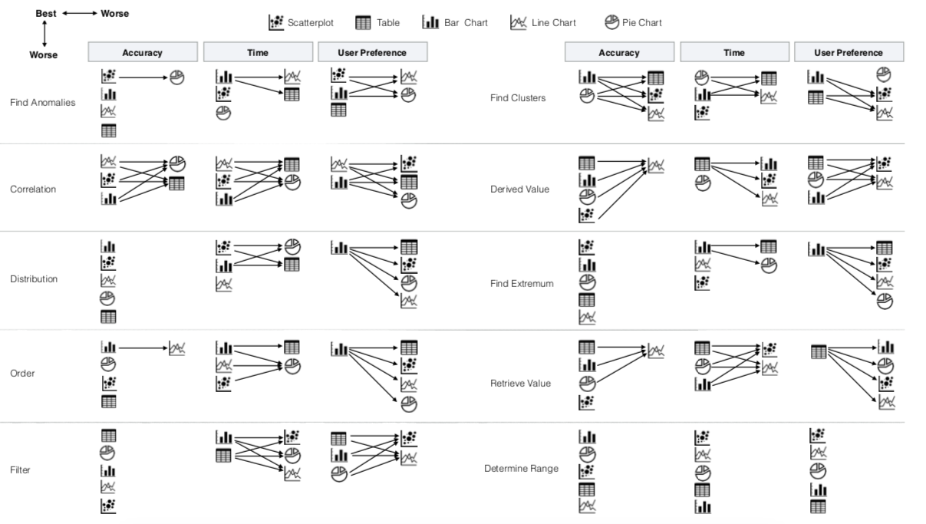
How to choose plot type?
Use bar charts for cluster identification, line charts for correlations & scatter plots for anomalies (Saket et al, 2018)

Slide 19
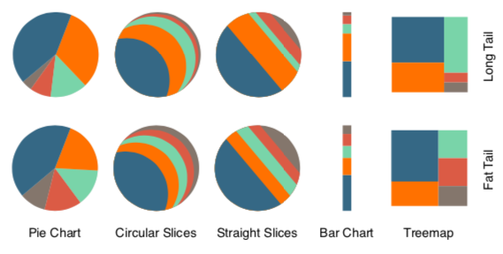
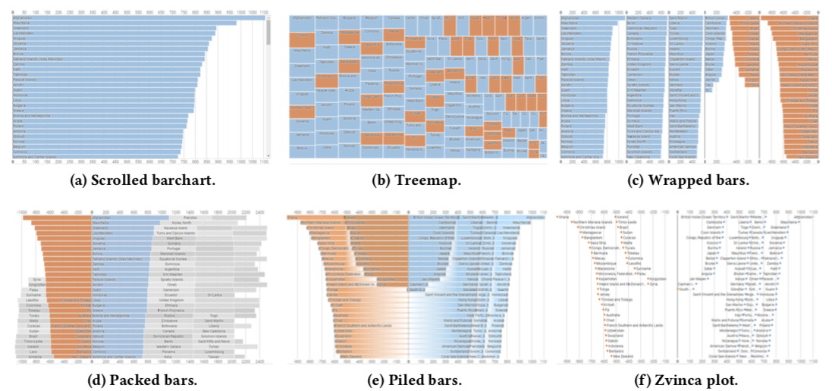
How to choose plot type?
Circular charts, including the unusual variations, perform better than the treemap; participants consistently spend more time reading the more familiar charts, in particular the pie chart one (Kosara, 2019)
Wrapped bars are the best choice for visualizing ranked lists; treemaps are surprisingly accurate despite the use of area rather than length to represent value (Mylavarapu et al, 2019)

Slide 20
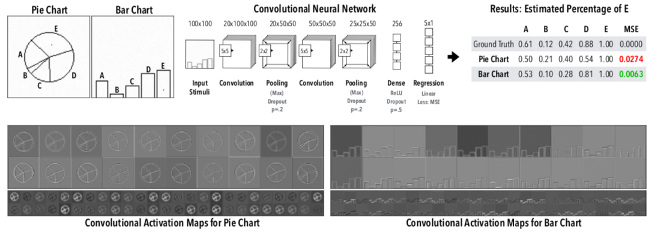
How to choose plot type?
CNNs can predict quantities more accurately from bar charts (Haehn et al, 2019)

Slide 21
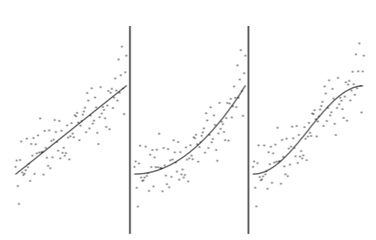
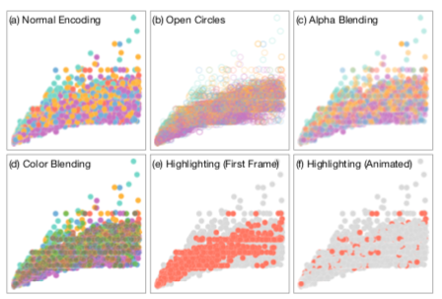
How to avoiding overplotting?
Analysts are good at estimating regression slopes and intercepts from scatter plots (Correll and Heer, 2017)
Animating specific classes aids distribution estimation (Chen et al, 2018)

Slide 22
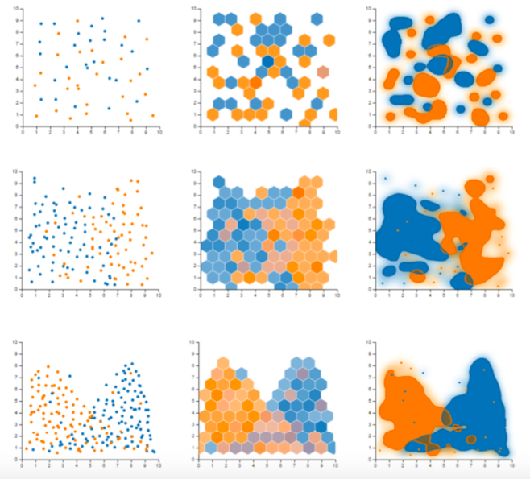
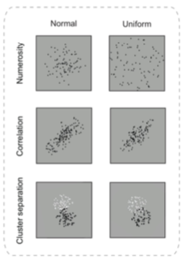
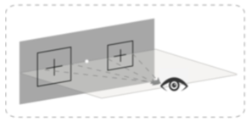
How to avoid bias?
Consider hexagonal binning or splatterplots for large samples (Sarikaya and Gleicher, 2019)
Be aware of perceptual bias in scaled scatter plots (Wei et al, 2019)

Slide 23
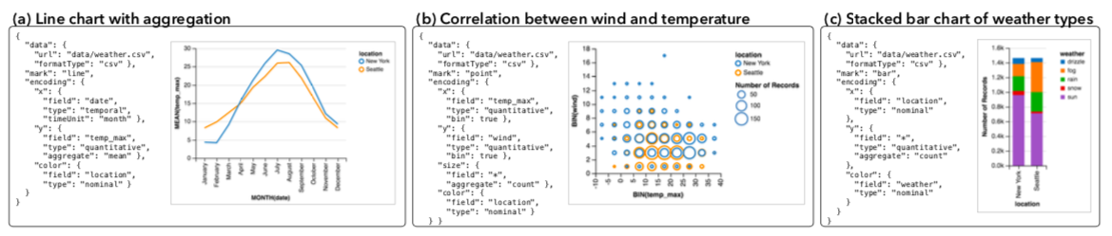
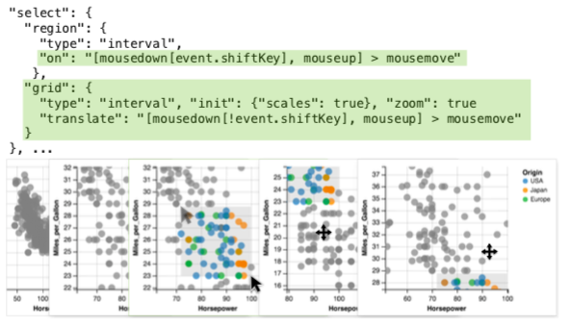
How do I plot? (frameworks)
Vega lite enables rapid prototyping of interactive visualizations by combining the traditional grammar of graphics and a novel grammar of interaction (Satyanarayan et al, 2017)
https://altair-viz.github.io

Slide 24
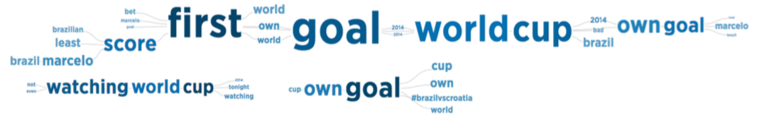
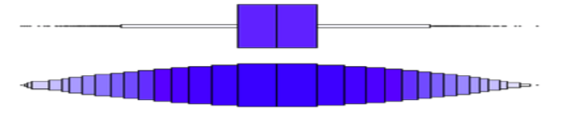
How do I plot? (methods)
SentenTree combines design ideas from word clouds and Word Tree and creates a node link diagram that incorporates words, co-occurrences and syntactic ordering in one plot (Hu et al, 2019)
https://github.com/twitter/SentenTree
hdoutliers correctly identifies outliers in multidimensional, massive data sets. This method builds a distributional model that allows outliers to be tagged with a probability (Wilkinson, 2019)
https://cran.r-project.org/web/packages/HDoutliers/index.html

Slide 25
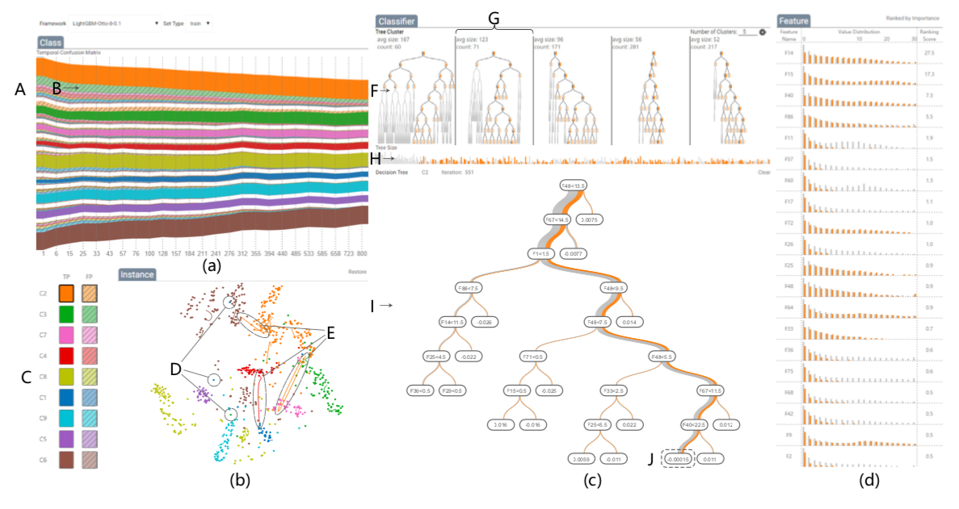
How do I plot model explainers?
BOOSTVis combines a temporal confusion matrix visualization, a t-SNE projection and a tree visualization to present an overall diagnosis of tree boosting models (Liu et al, 2018)
https://github.com/TangLin12/BOOSTVis2

Slide 26
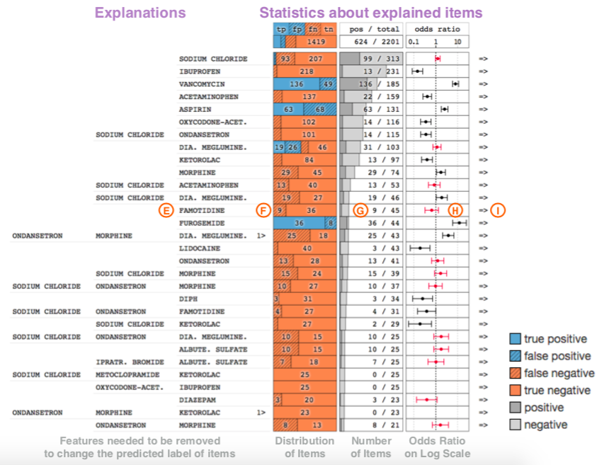
How do I plot model explainers?
By combining aggregate statistics on explanations attributed to individual features, it is possible to to derive insights on potential root causes for the observed patterns (Krause et al, 2017)
https://github.com/nyuvis/explanation_explorer

Slide 27
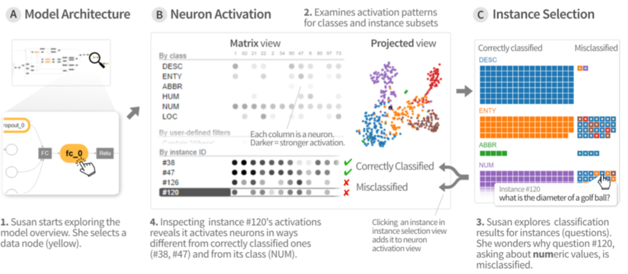
How do I plot model explainers?
Activis combines various phases of the model exploration process into screens and allows precise comparison of activation patterns across instances, subsets and classes (Kahng et al, 2017)

Slide 28
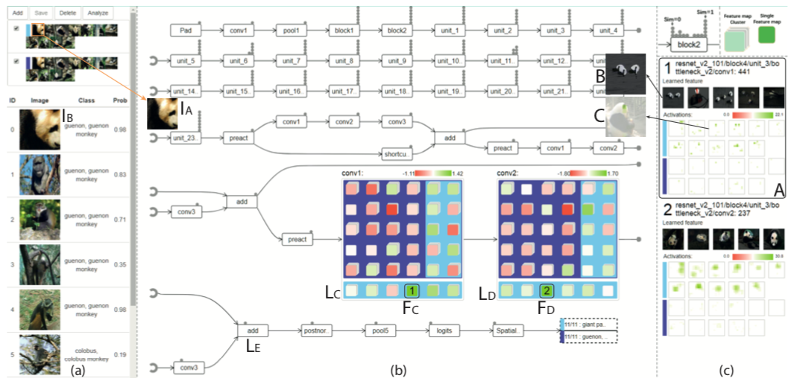
How do I plot model explainers?
By analyzing the datapaths of the adversarial examples and comparing them with those of the normal examples, we can understand the sources of misclassification (Kahng et al, 2017)

Slide 29
Thank you

